Slide 1
name : Sayan ghosh stream : bCA (2nd year) section : gamma; Sem: 3rd paper name : value & ethics of profession paper code : bcas 301 university roll no : 15201222165
topic : problems of technology transfer

Slide 2
PRESENTATION OF
“PROBLEMS OF TECHNOGY TRANSFER”
Technology transfer (TT), also called transfer of technology (TOT), is the process of transferring (disseminating) technology from the person or organization that owns or holds it to another person or organization, in an attempt to transform inventions and scientific outcomes into new products and services that benefit society. Technology transfer is closely related to (and may arguably be considered a subset of) knowledge transfer.
A comprehensive definition of technology transfer today includes the notion of collaborative process as it became clear that global challenges could be resolved only through the development of global solutions. Knowledge and technology transfer plays a crucial role in connecting innovation stakeholders and moving inventions from creators to public and private users.
Intellectual property (IP) is an important instrument of technology transfer, as it establishes an environment conducive to sharing research results and technologies. Analysis in 2003 showed that the context, or environment, and motives of each organization involved will influence the method of technology transfer employed. The motives behind the technology transfer were not necessarily homogenous across organization levels, especially when commercial and government interests are combined.

Slide 3
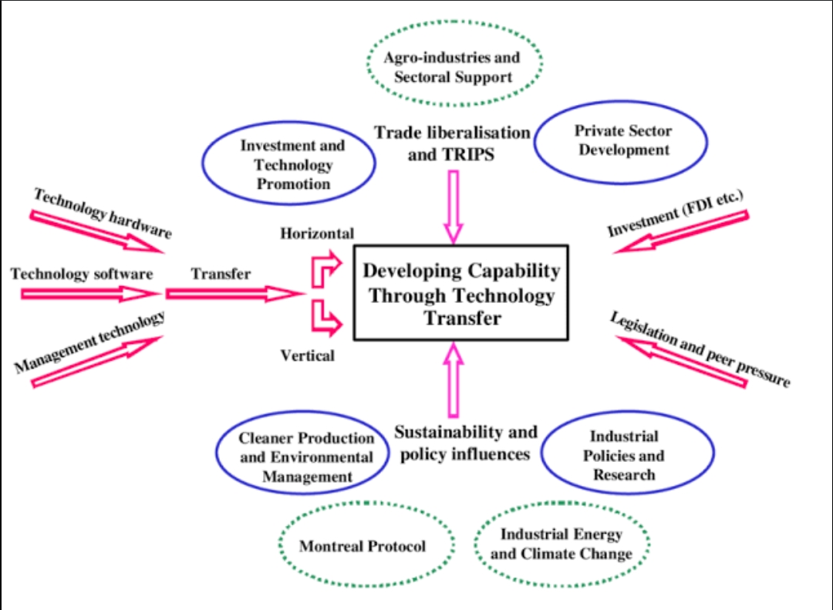
Technology transfer related issues & unido services :

Slide 4
PROBLEMS ENCOUNTERED IN TECHNOGY TRANFERED INCLUDE :
Limited general understanding of the concept of technology, and the lack of a consistent framework for its study.
Lack of systematic planning for technology transfer in developing countries or misunderstanding of its underlying philosophy.
Uncertainty surrounding the costs and benefits of adoption.
Asymmetric information on the value of the innovation.
Financial and skill requirements.
Externalities.
Regulatory barriers.

Slide 5
SOME OF THE BENEFITS OF TECHNOLOGY TRANSFERRED :
It leads to competitive advantage for a company to edge out its rivals .
It helps in research and development of a particular product which helps to take into account public and private need .
It leads to new technological innovations that can create new markets and consumers .
It helps develop early stage intellectual property into tools or products for public use .
It makes manual labor easy in the agricultural sector .
It advances the medical equipment and devices that improve health care .

Slide 6
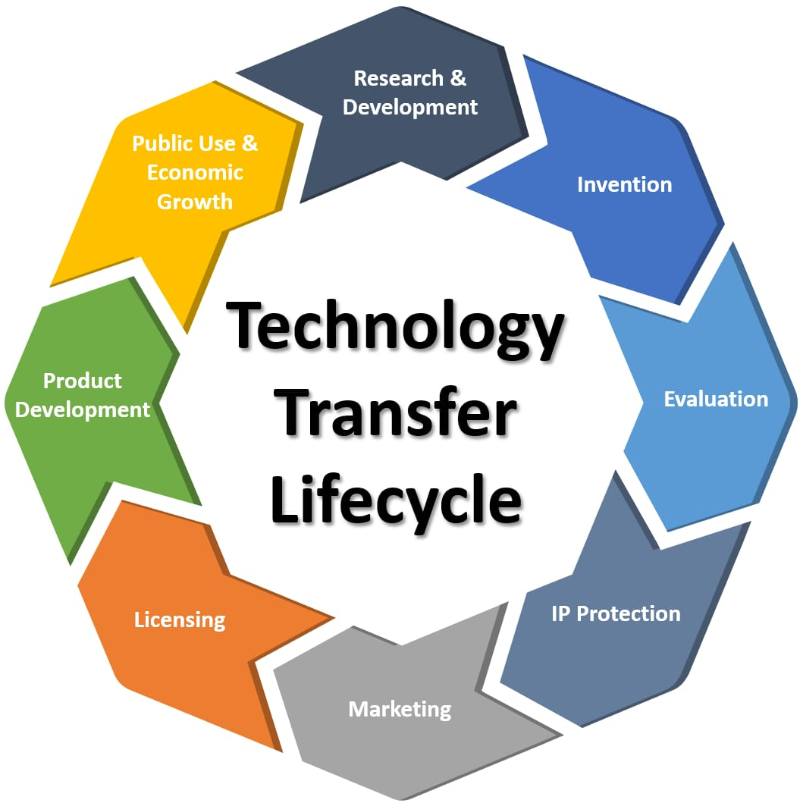
STRUCTURE OF TECHNOLOGY TRANSFER LIFECYCLE:

Slide 7
HOW TO TRANSFER THE MEASURE OF TECHNOLOGY TRANSFERRED :
Measuring the impact of technology transfer is a complex process. There are several metrics that can be used to measure the impact of technology transfer. According to , some of the metrics that can be used are:
Number of disclosures
Number of patents
Number of licenses
Number of spin-outs
Licensing income
However, these metrics have limitations and are not enough to measure the impact of technology transfer. The core metrics are proxies for impact, and there are many limitations to these metrics. The focus should be on measuring output rather than inputs, and on assuring the results are comparable, measurable, and consistent .

Slide 8
Technology transfer in practice :
Technology transfers may occur between universities, businesses (of any size, ranging from small, medium, to large), governments, across geopolitical borders, both formally and informally, and both openly and secretly. Often it occurs by concerted effort to share skills, knowledge, technologies, manufacturing methods, samples, and facilities among the participants.
While the Technology Transfer process involves many activities, which can be represented in many ways, in reality, technology transfer is a fluid and dynamic process that rarely follows a linear course. Typical steps include:
Knowledge creation
Disclosure
Assessment and evaluation
IP protection
Fundraising and technology development
Marketing
Commercialization
Product development, and
Impact.

Slide 9
END

